Slide 1
TEMPLATES

Slide 2
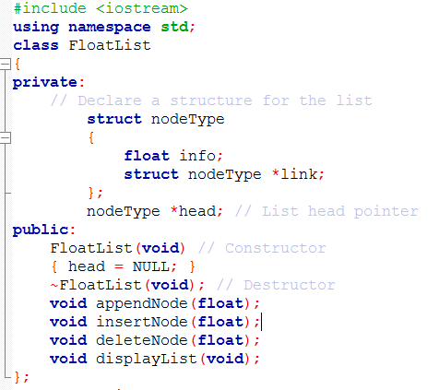
Link List
If we need to create three link lists:
One for float data
another for int data
And another for string data
will the class FloatList be sufficient ??

Slide 3
Template
Template concept can be applied to functions as well as classes
Template functions
Template Classes

Slide 4
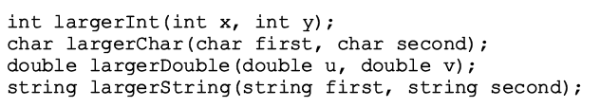
Template Functions
Templates allows programmers to write a SINGLE functions for a set of related functions
Lets take an example

Slide 6
Template Function
A template function will always start with a line as:
template <class Type>
OR
template <typename Type>
keyword class or typename can be used interchangeably

Slide 7
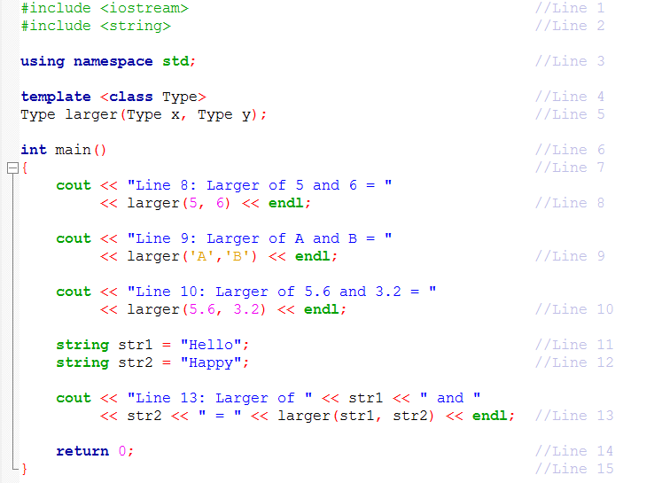
Example 2.7

Slide 8
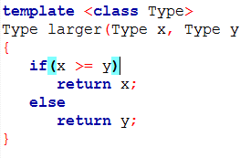
Example 2.7

Slide 9
Template Classes
chp2, p111-112

Slide 10
template classes
Write a single code segment for a set of related classes
Same template line before class definition as used in template functions
There is a slight change to making an object of a template class
class_name<data_type> object_name;

Slide 11

Template Link List class
FloatList class can be used create a link list of only float values
If link list is required for storing other data types as well, then either
as many link list classes needs to be defined, as many data types we want to store in the link lists OR
make a template link list, which will serve all the data types

Slide 12
Template Link List
The template link list can be used to create link list for
Basic data types, e.g., int, char, float etc
User defined classes
For user defined classes to be used with template link list, we may need to overload some operators
cout<<class_object in display
May be == , != in deletion

Slide 13
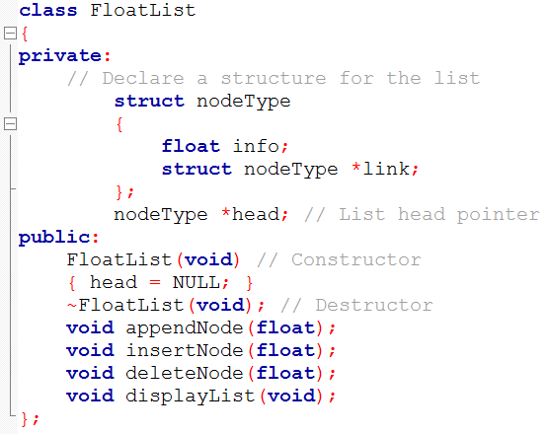


Link List

Slide 14
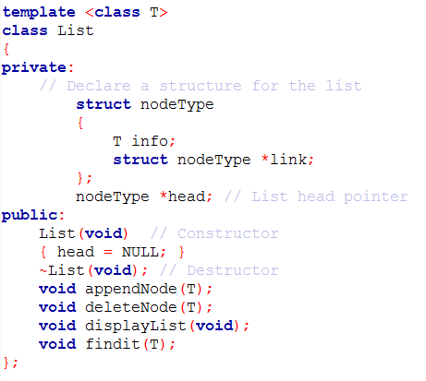
Template link list

Slide 15

template line
If class member functions are defined outside of class, then every function will also have the template line

Slide 16

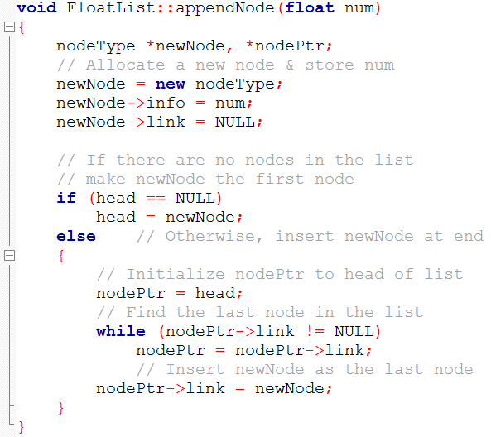

Slide 17
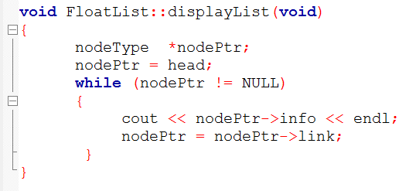

Slide 18

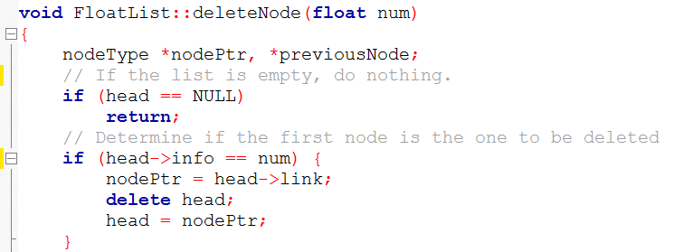
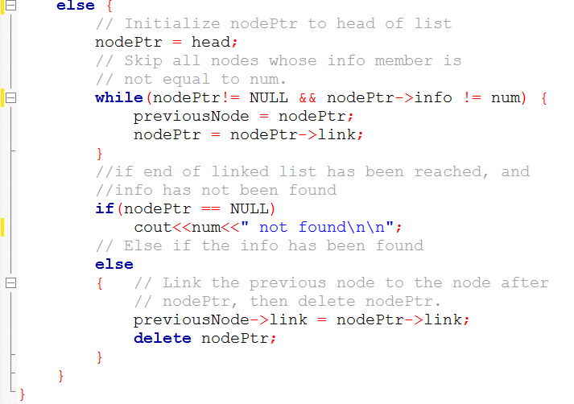

Slide 19
Template link list
Suppose we have a class Distance
class Distance {
int feet;
int inches;
}
What if we want to have a link list of Distance class.

Slide 20
Template Link List
If we are using template link list to store class objects, then some operators may need to be overloaded, e.g.,
<< operator
In displayList function, to print the data of class object

